Slide 1

Chapter 4
Basic Probability

Slide 2
Objectives
The objectives for this chapter are:
To understand basic probability concepts.
To understand conditional probability
To be able to use Bayes’ Theorem to revise probabilities
To learn various counting rules

Slide 3
Basic Probability Concepts
Probability – the chance that an uncertain event will occur (always between 0 and 1)
Impossible Event – an event that has no chance of occurring (probability = 0)
Certain Event – an event that is sure to occur (probability = 1)

Slide 4
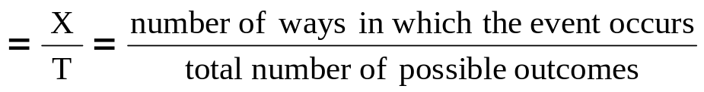
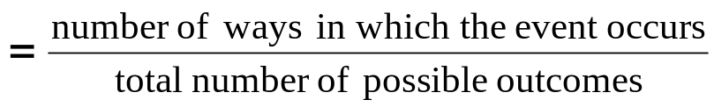
Assessing Probability
There are three approaches to assessing the probability of an uncertain event:
1. a priori -- based on prior knowledge of the process
2. empirical probability
3. subjective probability
probability of occurrence
Assuming all outcomes are equally likely
probability of occurrence
based on a combination of an individual’s past experience, personal opinion, and analysis of a particular situation

Slide 5

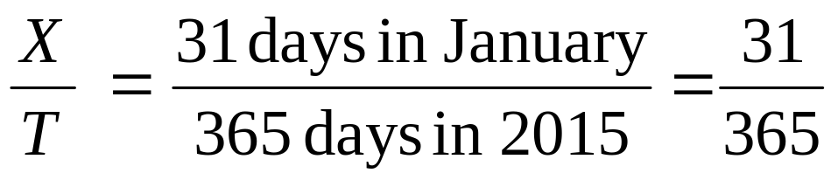
Example of a priori probability
When randomly selecting a day from the year 2015 what is the probability the day is in January?

Slide 6
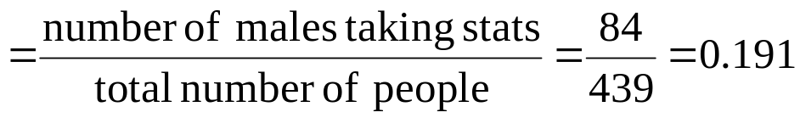
Example of empirical probability
Find the probability of selecting a male taking statistics from the population described in the following table:
 | Taking Stats | Not Taking Stats | Total
Male | 84 | 145 | 229
Female | 76 | 134 | 210
Total | 160 | 279 | 439
Probability of male taking stats

Slide 7
Subjective probability
Subjective probability may differ from person to person
  A media development team assigns a 60% probability of success to its new ad campaign.
  The chief media officer of the company is less optimistic and assigns a 40% of success to the same campaign
The assignment of a subjective probability is based on a person’s experiences, opinions, and analysis of a particular situation
Subjective probability is useful in situations when an empirical or a priori probability cannot be computed

Slide 8
Events
Each possible outcome of a variable is an event.
Simple event
  An event described by a single characteristic
  e.g., A day in January from all days in 2015
Joint event
  An event described by two or more characteristics
  e.g. A day in January that is also a Wednesday from all days in 2015
Complement of an event A (denoted A’)
  All events that are not part of event A
  e.g., All days from 2015 that are not in January

Slide 9

Sample Space
The Sample Space is the collection of all possible events
e.g. All 6 faces of a die:
e.g. All 52 cards of a bridge deck:

Slide 10
Organizing & Visualizing Events
Venn Diagram For All Days In 2015
Sample Space (All Days In 2015)
Days That Are In January and Are Wednesdays
January Days
Wednesdays

Slide 11
Organizing & Visualizing Events
(continued)
Contingency Tables -- For All Days in 2015
Decision Trees
Jan. Not Jan. Total
Wed. 4 48 52
Not Wed. 27 286 313
Total 31 334 365
4
27
48
286
Total
Number
Of
Sample
Space
Outcomes
Wed.
Sample Space
Jan.
All Days
In 2015
Not Wed.
Wed.
Not Jan.
Not Wed.

Slide 12
Definition: Simple Probability
Simple Probability refers to the probability of a simple event.
  ex. P(Jan.)
  ex. P(Wed.)
Jan. Not Jan. Total
P(Wed.) = 52 / 365
Wed. 4 48 52
Not Wed. 27 286 313
Total 31 334 365
P(Jan.) = 31 / 365

Slide 13
Definition: Joint Probability
Joint Probability refers to the probability of an occurrence of two or more events (joint event).
  ex. P(Jan. and Wed.)
  ex. P(Not Jan. and Not Wed.)
Jan. Not Jan. Total
P(Not Jan. and Not Wed.)
= 286 / 365
Wed. 4 48 52
Not Wed. 27 286 313
Total 31 334 365
P(Jan. and Wed.) = 4 / 365

Slide 14
Mutually Exclusive Events
Mutually exclusive events
  Events that cannot occur simultaneously
Example: Randomly choosing a day from 2015
  A = day in January; B = day in February
  Events A and B are mutually exclusive

Slide 15
Collectively Exhaustive Events
Collectively exhaustive events
  One of the events must occur
  The set of events covers the entire sample space
Example: Randomly choose a day from 2015
A = Weekday; B = Weekend;
C = January; D = Spring;
  Events A, B, C and D are collectively exhaustive (but not mutually exclusive – a weekday can be in January or in Spring)
  Events A and B are collectively exhaustive and also mutually exclusive

Slide 16
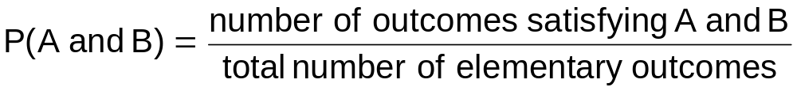
Computing Joint and
Marginal Probabilities
The probability of a joint event, A and B:
Computing a marginal (or simple) probability:
    Where B₁, B₂, …, B_{k} are k mutually exclusive and collectively exhaustive events

Slide 17
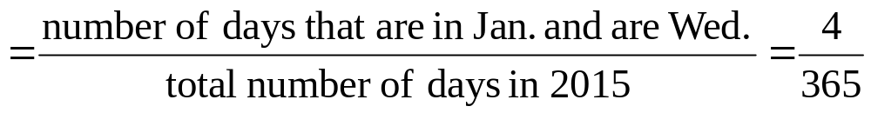
Joint Probability Example
P(Jan. and Wed.)
Jan. Not Jan. Total
Wed. 4 48 52
Not Wed. 27 286 313
Total 31 334 365

Slide 18
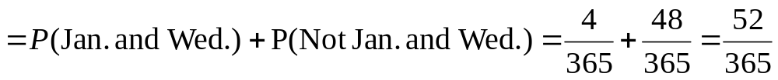
Marginal Probability Example
P(Wed.)
Jan. Not Jan. Total
Wed. 4 48 52
Not Wed. 27 286 313
Total 31 334 365

Slide 19
Marginal & Joint Probabilities In A Contingency Table
Event
Event
B₁
B₂
Total
A₁
P(A₁ and B₁)
P(A₁ and B₂)
P(A₁)
A₂
P(A₂ and B₁)
P(A₂ and B₂)
P(A₂)
Total
P(B₁)
P(B₂)
1
Joint Probabilities
Marginal (Simple) Probabilities

Slide 20

Probability Summary So Far
Probability is the numerical measure of the likelihood that an event will occur
The probability of any event must be between 0 and 1, inclusively
The sum of the probabilities of all mutually exclusive and collectively exhaustive events is 1
1
Certain
0 ≤ P(A) ≤ 1 For any event A
0.5
0
Impossible
If A, B, and C are mutually exclusive and collectively exhaustive

Slide 21
General Addition Rule
General Addition Rule:
P(A or B) = P(A) + P(B) - P(A and B)
If A and B are mutually exclusive, then
P(A and B) = 0, so the rule can be simplified:
P(A or B) = P(A) + P(B)
For mutually exclusive events A and B

Slide 22
General Addition Rule Example
P(Jan. or Wed.) = P(Jan.) + P(Wed.) - P(Jan. and Wed.)
= 31/365 + 52/365 - 4/365 = 79/365
Don’t count the four Wednesdays in January twice!
Jan. Not Jan. Total
Wed. 4 48 52
Not Wed. 27 286 313
Total 31 334 365

Slide 23
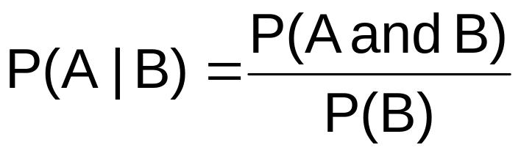
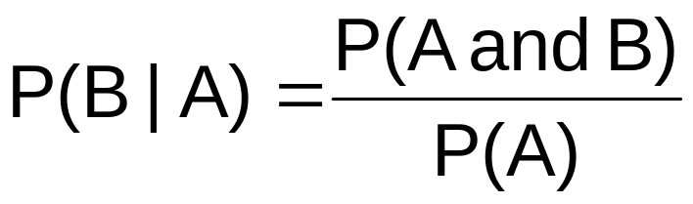
Computing Conditional Probabilities
A conditional probability is the probability of one event, given that another event has occurred:
The conditional probability of A given that B has occurred
The conditional probability of B given that A has occurred
Where P(A and B) = joint probability of A and B
P(A) = marginal or simple probability of A
P(B) = marginal or simple probability of B

Slide 24
Conditional Probability Example
Of the cars on a used car lot, 70% have air conditioning (AC) and 40% have a GPS. 20% of the cars have both.
What is the probability that a car has a GPS, given that it has AC ?
i.e., we want to find P(GPS | AC)

Slide 25

Conditional Probability Example
(continued)
Of the cars on a used car lot, 70% have air conditioning (AC) and 40% have a GPS and
20% of the cars have both.
GPS
No GPS
Total
AC
0.2
0.5
0.7
No AC
0.2
0.1
0.3
Total
0.4
0.6
1.0

Slide 26
Conditional Probability Example
(continued)
Given AC, we only consider the top row (70% of the cars). Of these, 20% have a GPS. 20% of 70% is about 28.57%.
GPS
No GPS
Total
AC
0.2
0.5
0.7
No AC
0.2
0.1
0.3
Total
0.4
0.6
1.0

Slide 27




Using Decision Trees
Given AC or no AC:
Has GPS
P(AC and GPS) = 0.2
P(AC)= 0.7
Does not have GPS
P(AC and GPS’) = 0.5
Has AC
All
Cars
Conditional
Probabilities
Does not have AC
P(AC’ and GPS) = 0.2
Has GPS
P(AC’)= 0.3
Does not have GPS
P(AC’ and GPS’) = 0.1

Slide 28



Using Decision Trees
(continued)
Given GPS or no GPS:
Has AC
P(GPS and AC) = 0.2
P(GPS)= 0.4
Does not have AC
P(GPS and AC’) = 0.2
Has GPS
All
Cars
Conditional
Probabilities
Does not have GPS
Has AC
P(GPS’ and AC) = 0.5
P(GPS’)= 0.6
Does not have AC
P(GPS’ and AC’) = 0.1

Slide 29

Independence
Two events are independent if and only if:
Events A and B are independent when the probability of one event is not affected by the fact that the other event has occurred

Slide 30
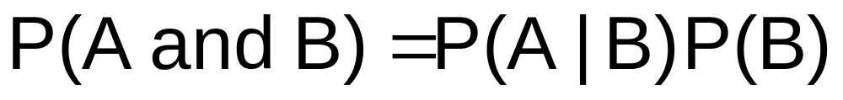

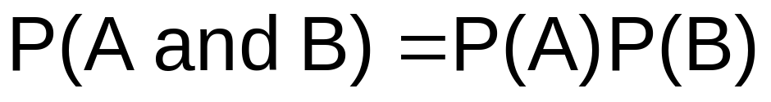
Multiplication Rules
Multiplication rule for two events A and B:
Note: If A and B are independent, then
and the multiplication rule simplifies to

Slide 31
Marginal Probability
Marginal probability for event A:
  Where B₁, B₂, …, B_{k} are k mutually exclusive and collectively exhaustive events

Slide 32
Bayes’ Theorem
Bayes’ Theorem is used to revise previously calculated probabilities based on new information.
Developed by Thomas Bayes in the 18th Century.
It is an extension of conditional probability.

Slide 33
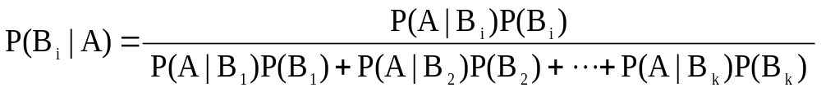
Bayes’ Theorem
where:
B_{i} = i^{th} event of k mutually exclusive and collectively
exhaustive events
A = new event that might impact P(B_{i})

Slide 34

Bayes’ Theorem Example
A drilling company has estimated a 40% chance of striking oil for their new well.
A detailed test has been scheduled for more information. Historically, 60% of successful wells have had detailed tests, and 20% of unsuccessful wells have had detailed tests.
Given that this well has been scheduled for a detailed test, what is the probability
that the well will be successful?

Slide 35
Bayes’ Theorem Example
(continued)
Let S = successful well
U = unsuccessful well
P(S) = 0.4 , P(U) = 0.6 (prior probabilities)
Define the detailed test event as D
Conditional probabilities:
    P(D|S) = 0.6 P(D|U) = 0.2
Goal is to find P(S|D)

Slide 36
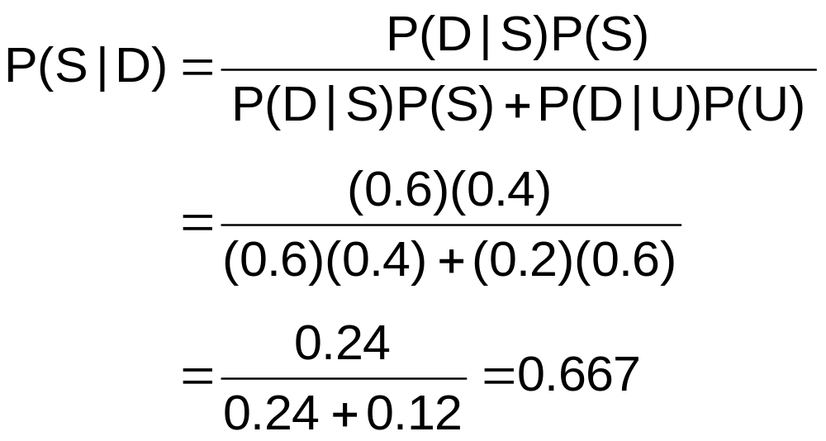
Bayes’ Theorem Example
(continued)
Apply Bayes’ Theorem:
So the revised probability of success, given that this well has been scheduled for a detailed test, is 0.667

Slide 37
Bayes’ Theorem Example
(continued)
Given the detailed test, the revised probability of a successful well has risen to 0.667 from the original estimate of 0.4
Event | Prior Prob. | Conditional Prob. | Joint Prob. | Revised Prob.
S (successful) | 0.4 | 0.6 | (0.4)(0.6) = 0.24 | 0.24/0.36 = 0.667
U (unsuccessful) | 0.6 | 0.2 | (0.6)(0.2) = 0.12 | 0.12/0.36 = 0.333
Sum = 0.36

Slide 38
Counting Rules Are Often Useful In Computing Probabilities
In many cases, there are a large number of possible outcomes.
Counting rules can be used in these cases to help compute probabilities.

Slide 39
Counting Rules
Rules for counting the number of possible outcomes
Counting Rule 1:
  If any one of k different mutually exclusive and collectively exhaustive events can occur on each of n trials, the number of possible outcomes is equal to
  Example
    If you roll a fair die 3 times then there are 6³ = 216 possible outcomes
k^{n}

Slide 40
Counting Rules
(continued)
Counting Rule 2:
  If there are k₁ events on the first trial, k₂ events on the second trial, … and k_{n} events on the n^{th} trial, the number of possible outcomes is
  Example:
    You want to go to a park, eat at a restaurant, and see a movie. There are 3 parks, 4 restaurants, and 6 movie choices. How many different possible combinations are there?
    Answer: (3)(4)(6) = 72 different possibilities
(k₁)(k₂)…(k_{n})

Slide 41
Counting Rules
(continued)
Counting Rule 3:
  The number of ways that n items can be arranged in order is
  Example:
    You have five books to put on a bookshelf. How many different ways can these books be placed on the shelf?
    Answer: 5! = (5)(4)(3)(2)(1) = 120 different possibilities
n! = (n)(n – 1)…(1)

Slide 42
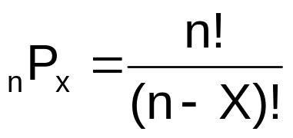
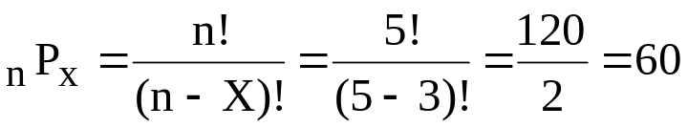
Counting Rules
(continued)
Counting Rule 4:
  Permutations: The number of ways of arranging X objects selected from n objects in order is
  Example:
    You have five books and are going to put three on a bookshelf. How many different ways can the books be ordered on the bookshelf?
    Answer: different possibilities

Slide 43
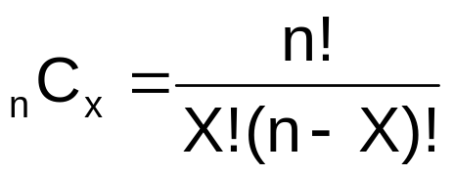
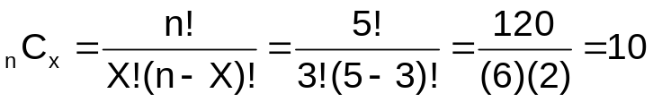
Counting Rules
(continued)
Counting Rule 5:
  Combinations: The number of ways of selecting X objects from n objects, irrespective of order, is
  Example:
    You have five books and are going to select three are to read. How many different combinations are there, ignoring the order in which they are selected?
    Answer: different possibilities

Slide 44
Chapter Summary
In this chapter we covered:
Understanding basic probability concepts.
Understanding conditional probability
Using Bayes’ Theorem to revise probabilities
Various counting rules

